Slide 1

Identifying Targetable Demographics for Test Prep Services
Conor Barry-Hoke
8 August 2018

Slide 2
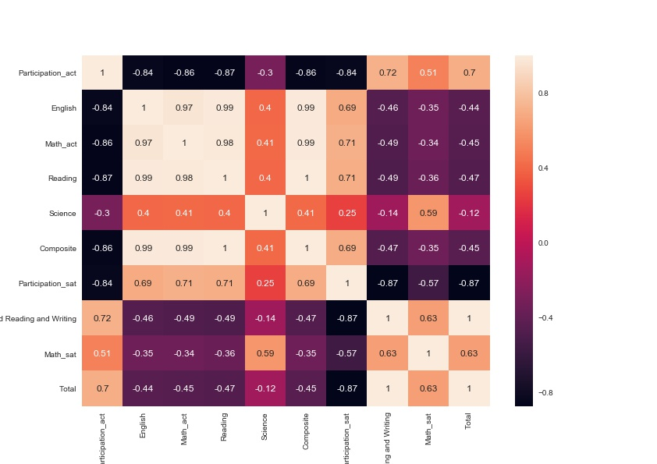

Slide 3
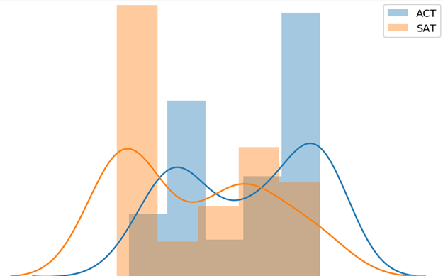
Test Preference

Slide 4
High ACT Participation, High SAT Scores
https://public.tableau.com/profile/conor.barry.hoke#!/vizhome/StandardizedTesting2/SATScoreACTPart

Slide 5
Clustered Sub-scores
https://public.tableau.com/profile/conor.barry.hoke#!/vizhome/StandardizedTesting2/Dashboard1?publish=yes

Slide 6
Who’s Doing the Best?
https://public.tableau.com/profile/conor.barry.hoke#!/vizhome/StandardizedTesting2/Squareplot

Slide 7
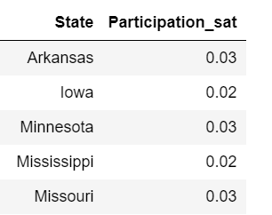
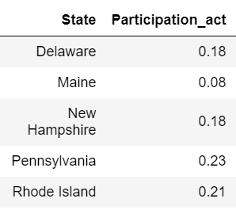
Identifiable Demographics: Where can we tailor the message?
Student Level
Students with one score much lower than the rest
Sub-score clustering indicates potential for scores to converge
Students who have only taken the dominant test for that state
Easy to pitch the second test, which tends to be higher score
State Level
High achievers in both tests
Iowa, Wisconsin, Missouri
Low achievers in both tests
Oklahoma, Florida, Georgia
Significant divergence in test scores
Minnesota, Idaho, Delaware, Mississippi

Slide 8
Proposal for Future Data Gathering
Examine state level data to gather percentile information for each state
Correlation at the student-level for test scores
Clear up whether smart kids are taking both or only the opposite test to stand out

Slide 9
END

